Slide 1

RELIABILITY OF SERVICE & LOGISTICS IN TEXAS

Slide 2

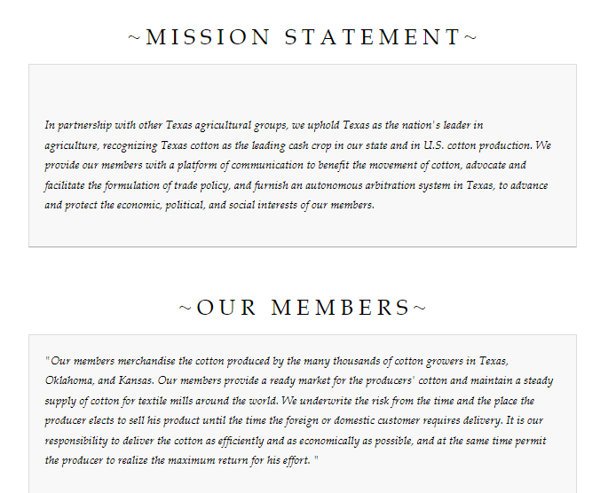
Notes:
Gunaydin!
On behalf of the TCA, I’d like to welcome you to Texas and the biggest cotton patch in the world!
Quickly about the TCA – our members provide a ready market and risk management for growers and textile mills. Our goal is to facilitate the efficient movement of cotton around the world.

Slide 3
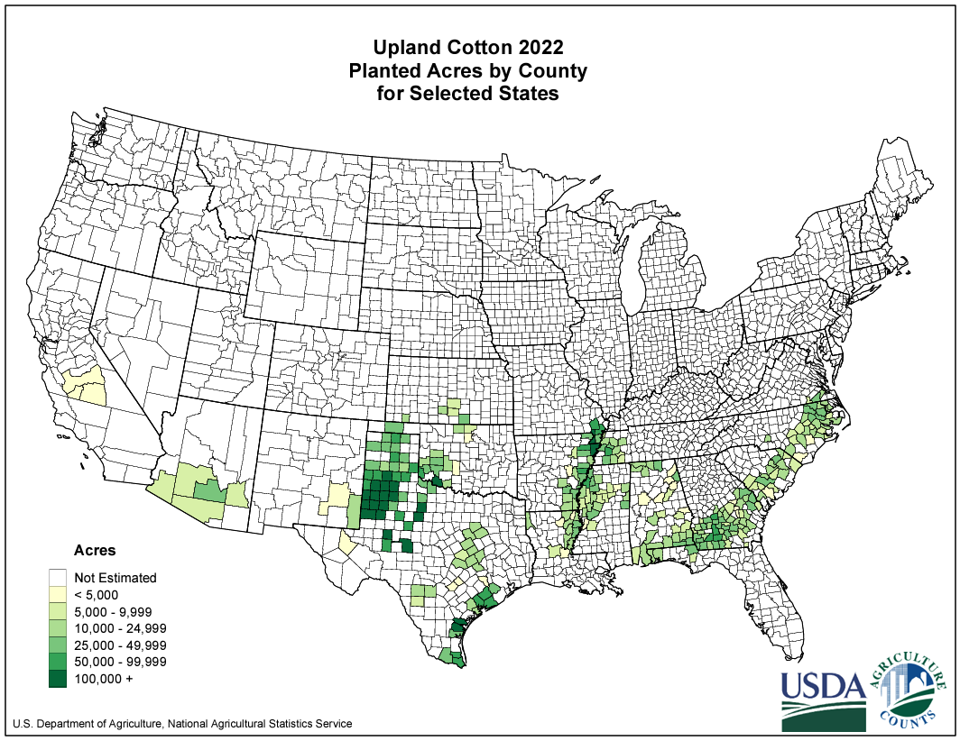
Importance of the Southwest Crop
Texas, Oklahoma, & Kansas combine to dominate planting each year.
“Make or break” markets with production.
Even on severe drought years, Texas produces the most cotton in the nation.
“How’s the crop in Texas?”
First AND last crop to be harvested in the USA.
Notes:
So why are you here? This is the most important cotton growing region in the world.

Slide 4
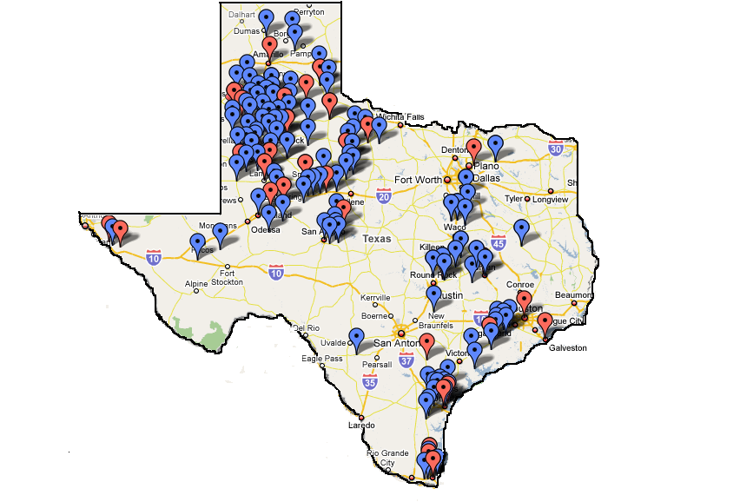

Texas Gins and Warehouse Locations
176 Active Cotton Gins
  88 Independent
  88 Cooperative
Warehouses
  Interior
  Trans-load/Port/Rail
Notes:
We have an efficient system of gins and warehouses; strategically located to facilitate the processing, storage, and eventual flow of Texas cotton.
- Excellent highway infrastructure and healthy rail options.
Strong economy in Texas allows for excellent trucking capacity along with plentiful container availability.
Port of Houston is the fastest growing port in the USA, which leads to very little congestion like we are seeing in Brazil currently.
Also, P.o.H. has no restrictions by the International Longshoremen’s Association (unlike disruptions we can often see on the East and West Coasts).

Slide 5
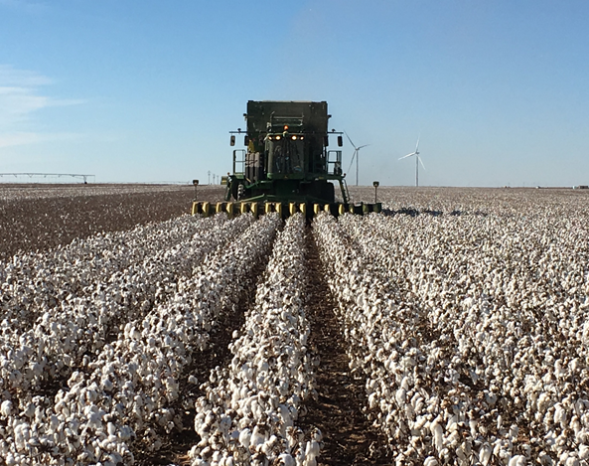
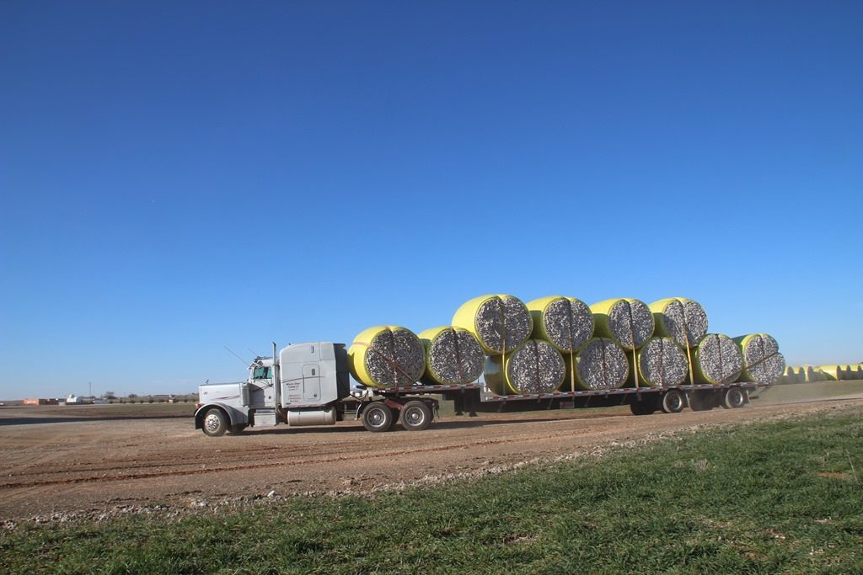

Quality from the Field…
Notes:
As Carlos mentioned, excellent fiber characteristics that improves year after year.
HOWEVER, Not just high grades though. Turkey has a strong history of needing lower grades…large crop = large variety.

Slide 6
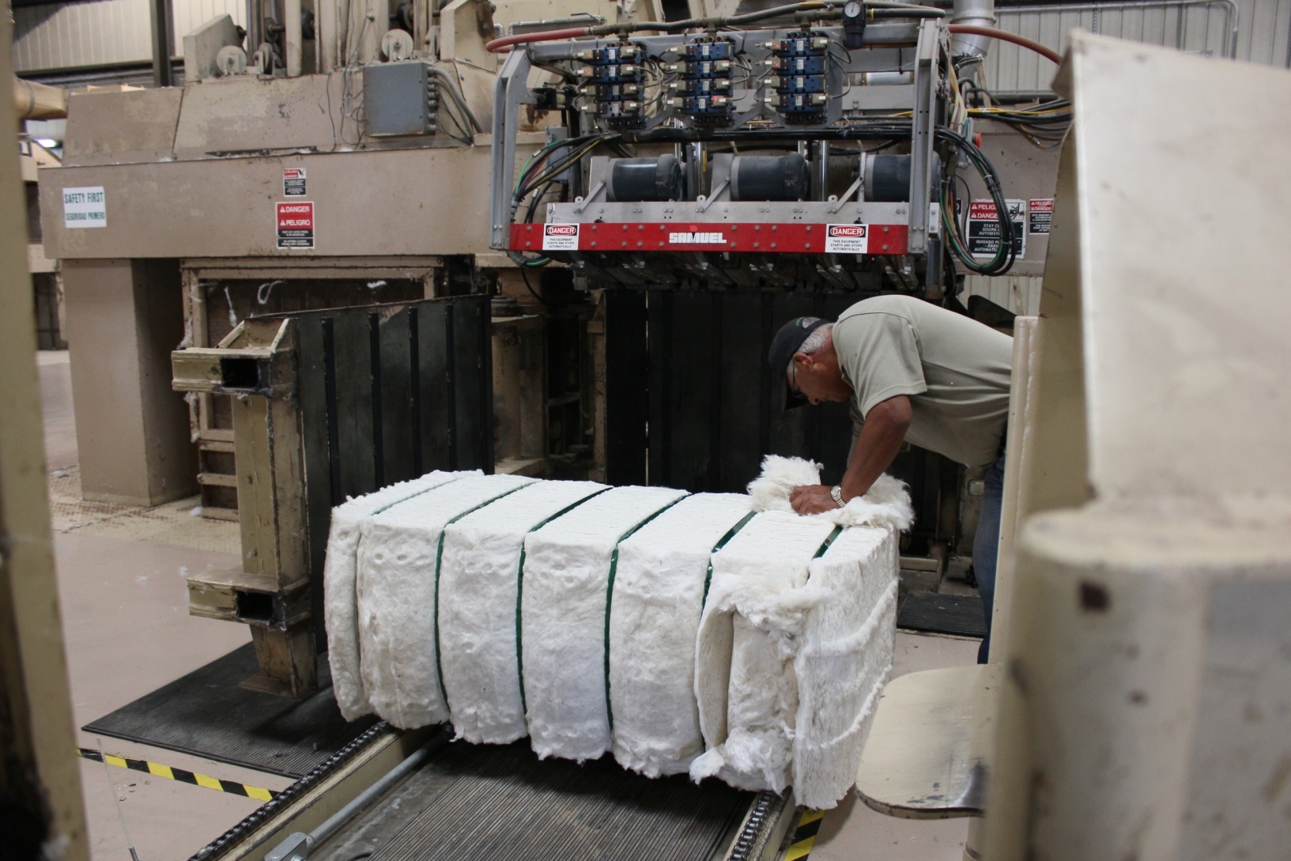
…Through Ginning
(Universal Density Bales)
Create an uniform dimensional bale that is acceptable to both domestic and international markets.
Establish a common trading unit of roughly 500 lb.
Improve handling and lowering of freight charges.
Minimize cost, reduce labor issues, improve bale packaging, and enhance warehouse stacking, which in turn increases efficiency and maintains quality.
Boost marketability to the mills in their handling, stacking, and processing in laydowns.
Notes:
6
Compressed bales @ the gin make for standard dimensions.
Better hedging with 500 lb units
Reduces cost to the entire supply chain through efficiency and consistency
Ultimately, lending to greater marketability of USA bales

Slide 7
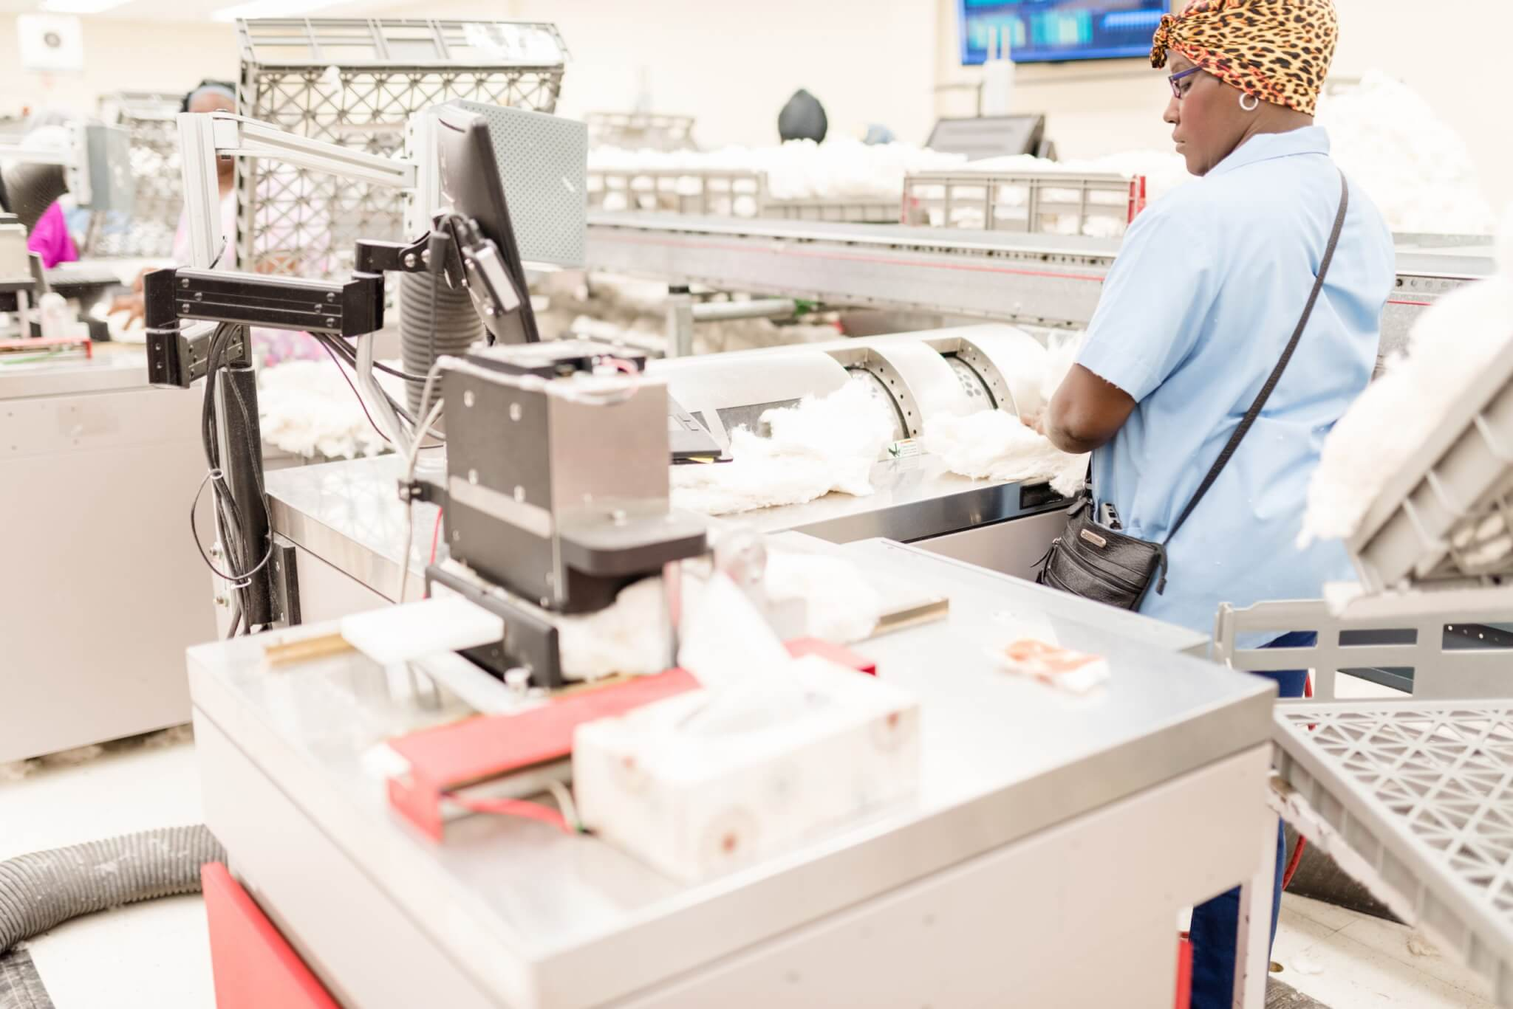
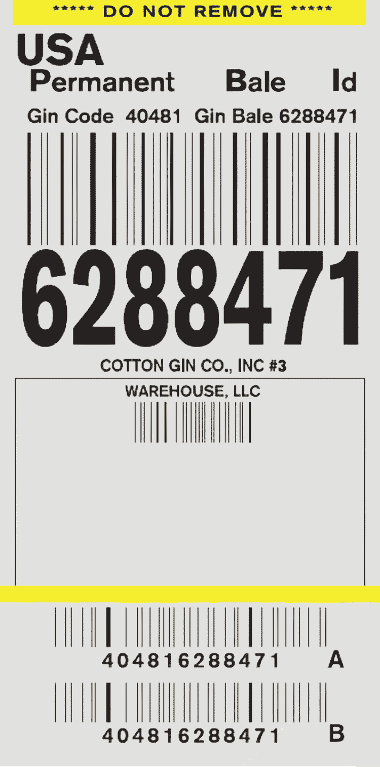

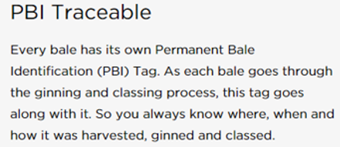
…Insuring Quality & Traceability
Notes:
With 100% of US production classed and the Permanent Bale Identification system, you do not have to worry about the quality or traceability of cotton.

Slide 8
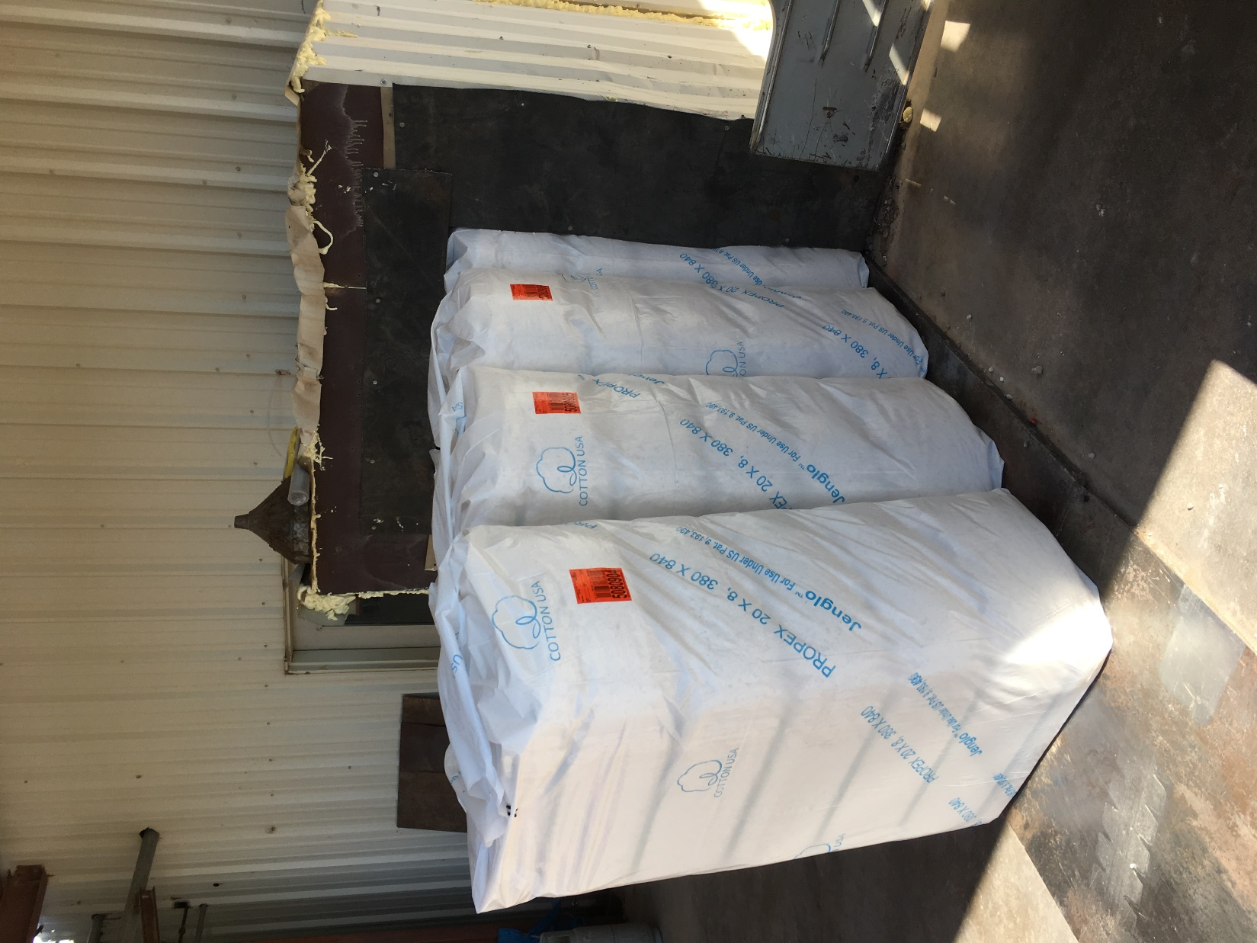
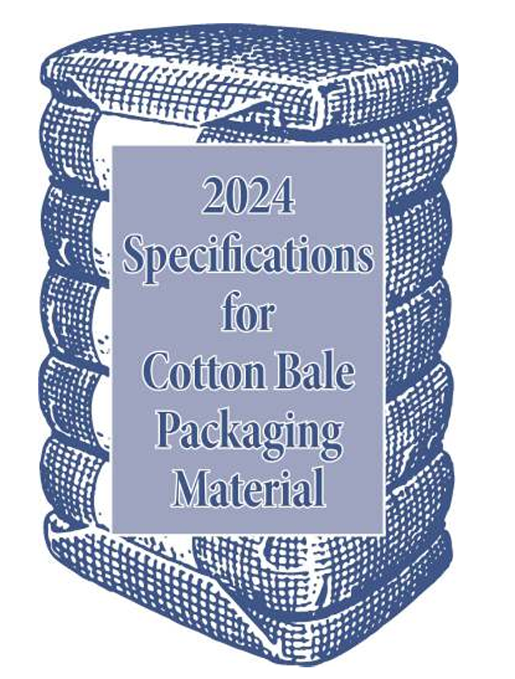
JOINT COTTON INDUSTRY BALE PACKAGING COMMITTEE
The mission of the JCIBPC is to “Preserve the quality of U.S. cotton fiber for mill consumption through the development of standards for cotton bales, including safe and environmentally friendly materials, methods and systems for packaging, handling and tagging.”
Notes:
8
Under the guidance of the National Cotton Council, the Bale Packaging Committee approves specifications of packaging to ensure the quality and protection of the cotton bale while preserving appearance and marketability for domestic and export markets.

Slide 9
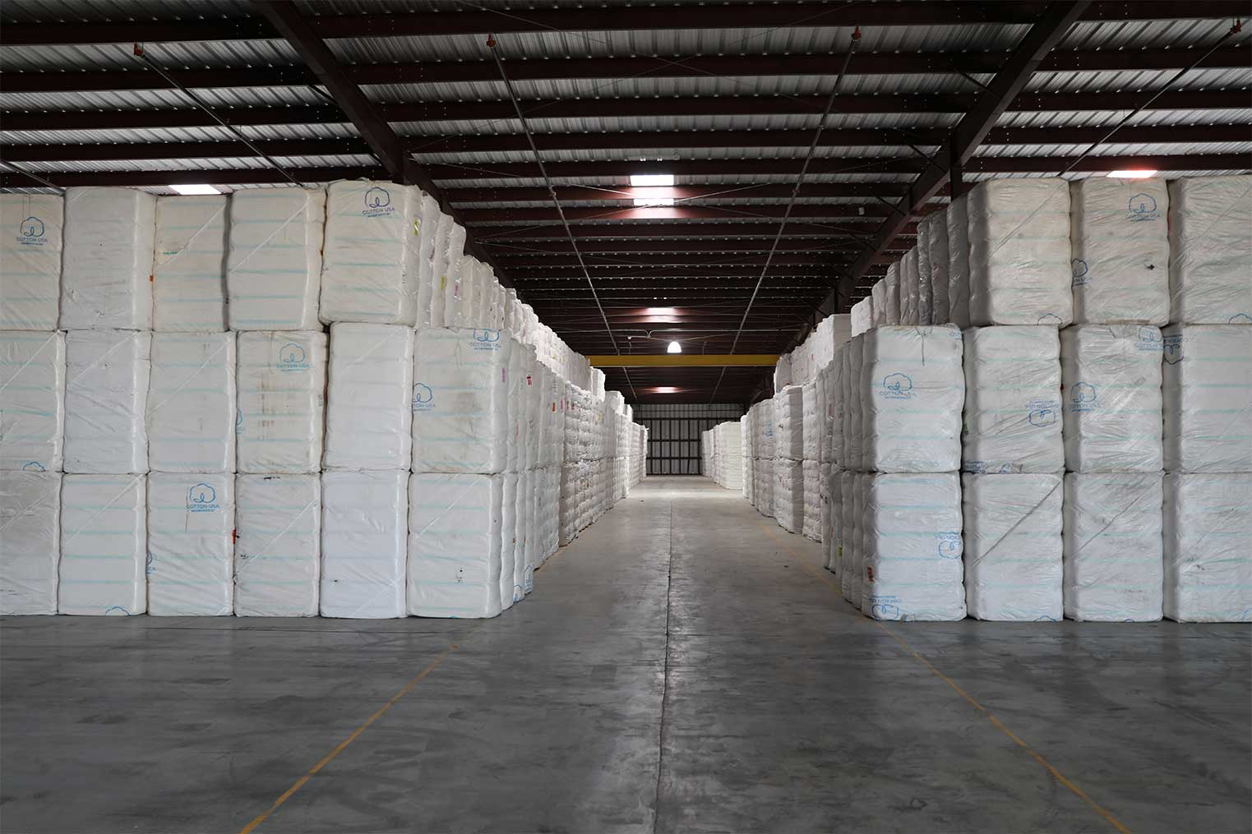
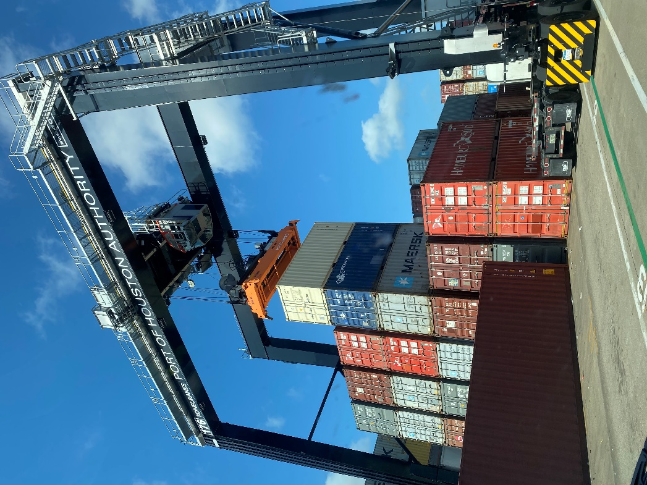
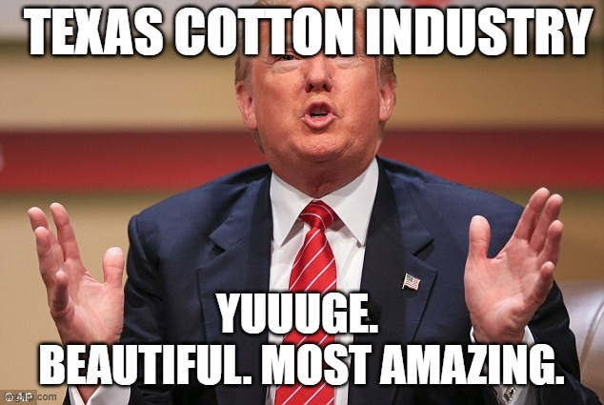
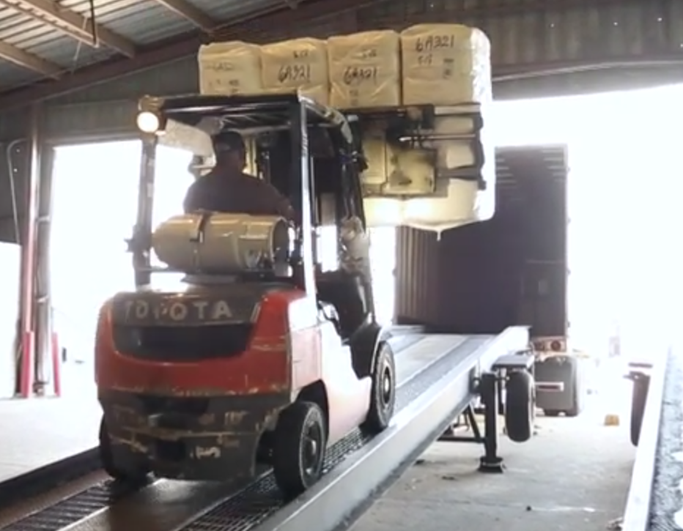
Notes:
How to tie the Flow Together…

Slide 10

Annual event held late Summer/early fall in Lubbock.
Since 1973, bring together all segments of the industry to discuss the flow of cotton based on upcoming crop size.
Hear about potential issues that could impede flow.
Work towards common goals to mitigate those issues.
The USA grows the most desirable crop that world wants AND needs.
We must ensure timely deliveries to create success for the entire supply chain – farmers to brands/retailers.
Notes:
Not just a shameless plug for our upcoming Flow Meeting…
Merchants vs Warehouses. Warehouses VS Truckers. Internal logistics teams Vs EVERYONE!
Relationships are key in this business. Don’t always agree
Locally, many of use meet together every other week @ Plains Cotton Growers. Probably not replicated anywhere else in the USA, maybe the world.

Slide 11

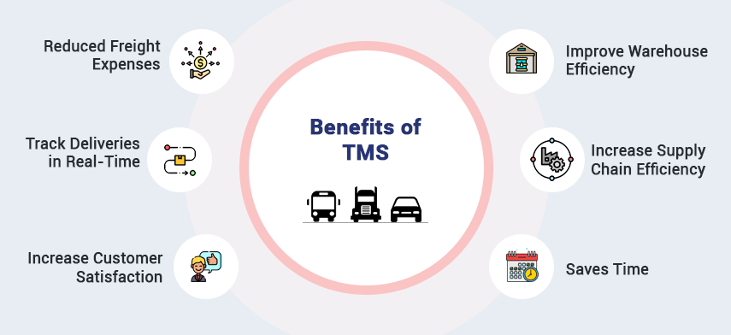
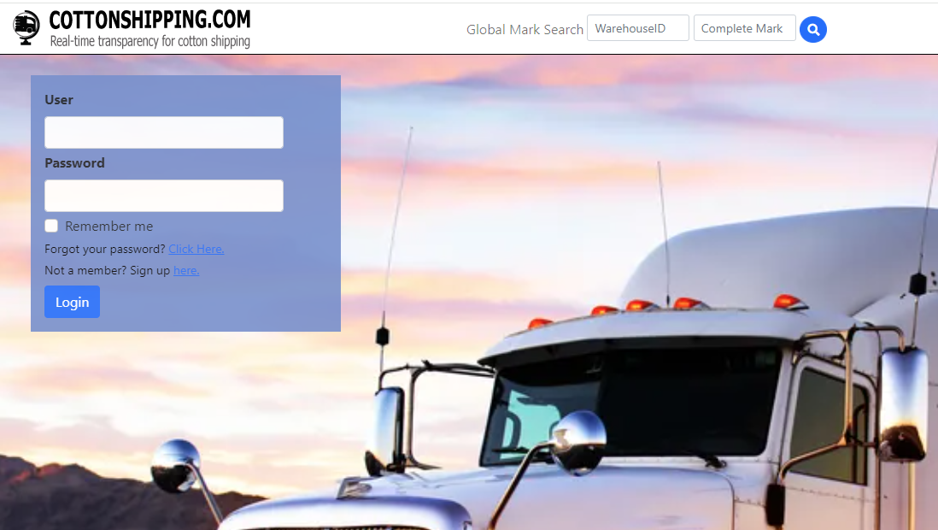


Technology & Trade Improvements
Transportation Management Systems
Notes:
Reached out to several industry leaders asking for some help & guidance with this presentation (purchasing focus vs sales). CCI group from Turkey…what do you want to tell them? What can we highlight? What’s on the horizon?
All responses mentioned…GREATER VISIBILITY & COMMUNICATION as being keys to success:
- Electronic Warehouse Receipts – Single most important…been around since 1995 (AV story about smoking Esteve Bros)
- Cotton Shipping.com (previously “Is My Load Ready”)
- Transportation Management Platforms – allow faster data exchange with Road carriers, Ocean Carriers, as well as Ports
Utilization of the GSM Program
What will Artificial Intelligence bring to the future? Blockchain, digital banking/documentation enhancements.

Slide 12
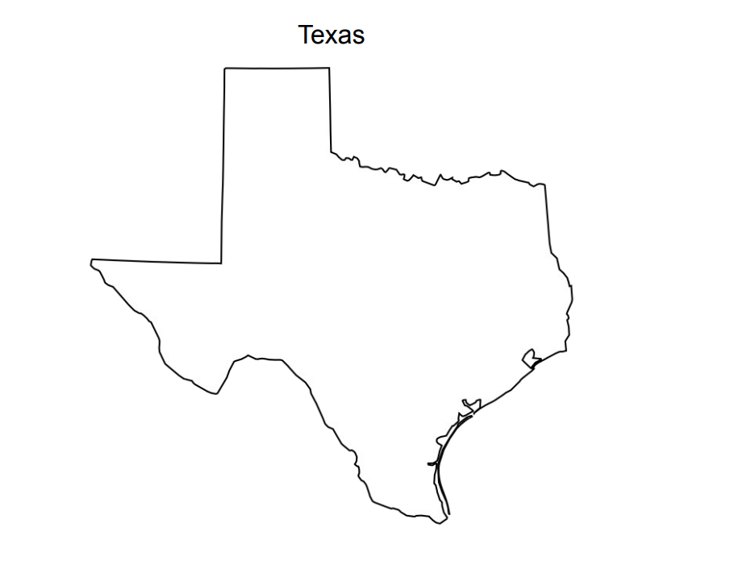
LA/Long Beach via rail from DFW/LBB/Altus
Domestic Mill or Savannah, GA via rail
WTX/OK/KS 5.0m bales avg
Houston via truck; container to port
Southwest Flow
Domestic = 5%
Mexico = 10%
Coastal Ports = 85%
Port of Houston – Export
DFW Container Port
STX
1.5m bales avg
Laredo Export to Mexico
Mexico via truck
Weslaco Export to Mexico
Notes:
95% exported, of which 10% to Mexico
Knowing that we must provide WHAT you need and WHEN you need it, the Texas industry knows it must execute at a high level.
This gets even more heightened with a strong likelihood of 7+ mil bales of production on the horizon for 2024/25. We typically produce 40%-45% of the US crop.
But Southwest growers, ginners, warehouses, merchants, freight companies…just the whole supply chain has been hurting in recent years. We are needing a win.
So with that let’s take a look at your consumption over the years.

Slide 13

US Upland Exports to Turkey (k bales)

Slide 14
US Exports to Turkey relative to total exports (%)
Notes:
Even as the net volume of exports was lower in 2023, Turkey continues to hold great importance in the relative total exports for US cotton.
Turkey consistently is a top 5 destination.

Slide 15
UPL Exports to Turkey relative to U.S. crop size (%)
Notes:
On average, the USA exports around 10% of its crop. However, we saw a steep decline in 2023 mostly due to:
The devastating earthquake in February of 2023
Significantly smaller crop in the USA last yr
Brazil having a large crop and selling it much cheaper

Slide 16
U.S. Exports to Turkey by Port (%)
Notes:
Just thought it was interesting to show the volumes of cotton by port.
Savannah increasing due to:
smaller US domestic consumption,
favorable trade lines from DFW to Savannah,
two years of smaller crops in TX.

Slide 17
Turkey: Imports by Origin (k MT)
Notes:
The US is still the top supplier for Turkey, but just by a narrow margin as we see Brazil % increasing.
We are keenly aware of Brazil’s rise in production over the past few years. However, for the cleanest, most reliable production in the world, the choice will always be the USA.

Slide 18
Turkey: Imports from the U.S. (k MT)
Notes:
USA has an overall declining share of Turkish imports. Just 10 years ago (and as recent as 2017), the USA was supplying over 50% of Turkish import volumes.
The goal of your delegation is come see, hear, and learn more about USA cotton. But today, you are in Lubbock, TX. And my goal is to encourage you, to buy Texas cotton.
Seen our harvest and ginning in the Rio Grande Valley
Learned about our production practices from Plains Cotton Growers
Seen the various fiber qualities we grow from Carlos.
And next you’ll hear about our incredible sustainability and traceability claims, that likely no other nation can come close to, from Daren and the USCTP.
But if you can take ONE thing away from your entire trip…remember the next slide.

Slide 19


BUY MORE TEXAS COTTON
Notes:
I love meme’s.

